Slide 1
The American Rescue Plan Act – Kickoff Webinar with Barnes & Thornburg LLP

Slide 2
Barnes & Thornburg LLP ARPA Team
Thomas McGonigle
Jacob German
Matt Morgan
Veronica Schilb
Dustin Meeks

Slide 3
Overview of ARPA
Significant increase in government expenses since pandemic began.
Section 602 and 603 of ARPA establishes the Coronavirus Local Fiscal Recovery Fund to help respond to and contain the impact of COVID-19.
  Sections 602 and 603 contain the same eligible uses. Section 602 establishes a fund for States, territories, and Tribal governments; and section 603 establishes a fund for metropolitan cities, nonentitlement units of local government, and counties.
$19.5 billion in total aid going to non-entitlement units of local government.
$43.96 million going to Delaware’s 55 non-county non-metropolitan governments in 2021.
  Refer to Appendix A for breakout.
Notes:
Link to County Data: fiscalrecoveryfunds_countyfunding_2021.05.10-1a table .xlsx (treasury.gov)
Link to City Data: Local Allocations in the American Rescue Plan Act - National League of Cities (nlc.org)
Link to NEU Data: American Rescue Plan Act of 2021 (ARPA) - Dashboard - State Treasurer Colleen C. Davis - State of Delaware

Slide 4
Overview – Permissible Uses
Public health and economic impacts
Premium pay for essential workers
Replacing lost public sector revenue
Investments in infrastructure
  Water
  Sewer
  Broadband

Slide 5
Overview – Exclusions
Section 603(2) - No metropolitan city, nonentitlement unit of local government, or county may use funds made available under this section for deposit into any pension fund.
Lost revenue recoupment shall not be used for “rainy day” or reserve funds, or debt service payments.
Recovery funds may not be used as non-federal match, unless specifically authorized by the underlying/source federal program.
  However, local communities may use their funds to match other state and local government allocations of Treasury ARPA Recovery Funds, if used within the local community.

Slide 6
Public Health and Economic Impacts
Supports public health responses by funding COVID-19 mitigation efforts, medical expenses, behavioral health care and certain local community public health, public safety, human services and other related staff.
Addresses negative economic impacts to workers, families, small businesses, impacted industries, and rehiring of public sector workers.
Funds must respond to “the disease itself or the harmful consequences of the economic disruptions resulting from or exacerbated by the COVID-19 public health emergency.”
Qualifying programs or services must respond to the COVID-19 public health emergency. When assessing such programs or services:
  First, identify a need or negative impact of the COVID-19 public health emergency; and
  Second, identify how the program, service, or other intervention addresses the identified need or impact.

Slide 7
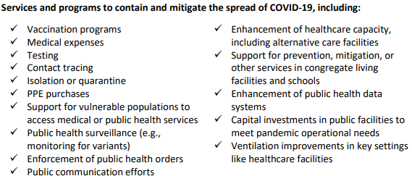
Public Health and Economic Impacts – Examples

Slide 8
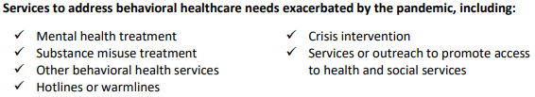

Public Health and Economic Impacts – Examples (cont.)

Slide 9
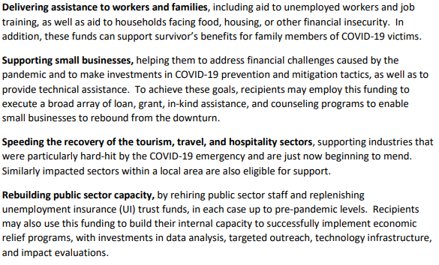
Public Health and Economic Impacts – Examples (cont.)
Addressing the negative economic impacts :

Slide 10
Premium Pay for Essential Workers
Can be provided essential workers in the community that have faced, and continue to face, the greatest health risks due to their service.
  Essential work = work involving regular in-person interactions or regular physical handling of items that were also handled by others.
Section 603(g)(2): essential workers are those needed to maintain continuity of operations of essential critical infrastructure sectors and additional sectors designated as critical.
  The chief executive officer of a metropolitan city, nonentitlement unit of local government, or county may designate sectors as critical.
  These sectors must protect the health and well-being of the residents of their metropolitan city, nonentitlement unit of local government, or county.

Slide 11
Premium Pay for Essential Workers – Examples
Any work performed by an employee of the state, local or tribal government
Staff at nursing homes, hospitals, and home care settings
Workers at farms, food production facilities, grocery stores, and restaurants
Janitors and sanitation workers
Truck drivers, transit staff and warehouse workers
Public health and safety staff
Childcare workers, educators and other school staff
Social service and human services staff

Slide 12
Premium Pay for Essential Workers (cont.)
Section 603(g)(6): Offers additional compensation, up to $13 per hour in additional wages.
  Amounts may not exceed $25,000 for a single eligible worker.
Should prioritize low- and moderate-income persons (additional justification needed for workers above 150 percent of the residing state’s average annual wage).
May provide retroactively, dating back to the start of the public health emergency on January 27, 2020.
May be provided to third-party employers.

Slide 13
Replacing Lost Public Sector Revenue
This provision allows a much broader use of funds.
Provides funds to government services to the extent of the reduction in revenue experienced during the pandemic.
Revenue includes taxes, current charges, miscellaneous general revenue, and intergovernmental transfers between state and local governments.
Government services includes (but not limited to):
  Maintenance or pay-go funded building of infrastructure, including roads;
  Modernization of cybersecurity, including hardware, software, and protection of critical infrastructure;
  Health services;
  Environmental remediation;
  School or educational services; and
  Provision of police, fire, and other public safety services.

Slide 14
Replacing Lost Public Sector Revenue (cont.)
Reduction in revenue is based on comparing actual revenue to the expected revenue with no pandemic.
  Based on the expected trend by taking the last full fiscal year prior to the public health emergency (ex. January 27, 2020) and projecting forward with either:
    (a) the recipient’s average annual revenue growth over the three full fiscal years prior to the pandemic; or
    (b) 4.1 percent (the national average of state and local revenue growth rate from 2015-2018).
  Actual revenue = revenues collected over the past 12 months of the calculation date.
Avoid cuts to government services and government staff.

Slide 15
Investments in Infrastructure
Makes necessary investments in water, sewer, and broadband infrastructure.
Includes investing in improving access to clean drinking water, in wastewater and stormwater infrastructure, and in providing underserved or underserved locations with new or expanded broadband access.
Does not include other general economic development and infrastructure projects (ex. road construction, bridge repairs, etc.).
  Such projects must be funded through a local government’s lost revenue replacement allowance.

Slide 16
Investments in Infrastructure: Water and Sewer
Aligns eligible projects with those that qualify through the Environmental Protection Agency’s (EPA), Clean Water State Revolving Fund (CWSRF), and Drinking Water State Revolving Fund (DWSRF).
Examples of projects:
  Stormwater runoff;
  Water pollution;
  Flood control; and
  Green infrastructure that support stormwater resiliency, including rain gardens and green streets.

Slide 17
Investments in Infrastructure: Water and Sewer (cont.)
Examples of CWSRF projects are those to:
  Construct, improve, and repair wastewater treatment plants;
  Control non-point sources of pollution;
  Improve resilience of infrastructure to severe weather events;
  Create green infrastructure; and
  Protect waterbodies from pollution.
Examples of DWSRF fund uses:
  Assist communities in making water infrastructure capital improvements, including the installation and replacement of failing treatment and distribution systems;
  Ensure compliance with applicable health and environmental safety requirements;
  Address the most serious risks to human health; and
  Assist systems most in need on a per household basis according to State affordability criteria.

Slide 18
Other Project Examples
Small business grant programs.
Support to tourism industry.
Non-profit organization grants.
Household assistance program.
Low income housing development.
Promoting enhanced public safety response.
PPE and cleaning services.
Cybersecurity.
Renovations to local government buildings to mitigate the spread of COVID-19.
Investments in COVID-19 testing and vaccine administration.
Grants for behavioral and mental health service providers.
Support for projects related to better health outcomes.
Support for projects related to early childhood development.

Slide 19
Compliance and Potential Changes
Funds must be incurred by December 31, 2024 and expended by December 31, 2026.
  Costs for projects incurred by the recipient State, territorial, local, or Tribal government prior to March 3, 2021 are not eligible.
  Treasury’s Interim Final Rule provides that “incurred” has the same meaning given to “financial obligation” in 2 CFR § 200.1.
    Financial obligations = when referencing a recipient's or subrecipient's use of funds under a Federal award, means orders placed for property and services, contracts and subawards made, and similar transactions that require payment. 2 CFR § 200.1.
Allow local governments to allocate up to $10 million in ARPA Recovery Funds for the provision of government services without being required to calculate revenue loss.
Allow $10 million (or 30 percent) of a local government’s ARPA Recovery Fund allocation to be used for infrastructure-related activities authorized under existing federal surface transportation laws or a Community Development Block Grant project.
Allow ARPA Recovery Funds to provide emergency relief from natural disasters and their negative economic impacts, including temporary emergency housing, food assistance, financial assistance for lost wages, or other immediate needs.

Slide 20
Programmatic Updates and
Q&A

Slide 21
Thank You
Thomas McGonigle; Thomas.McGonigle@btlaw.com; (302) 300-3472
Jacob German; Jacob.German@btlaw.com; (317) 231-7538
Matt Morgan; MMorgan@btlaw.com; (317) 231-7258
Veronica Schilb; Veronica.Schilb@btlaw.com; (317) 229-3178
Dustin Meeks; Dustin.Meeks@btlaw.com; (317) 231-6427

Slide 22
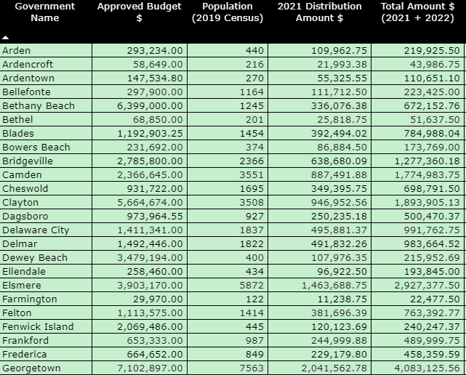
Appendix A-1 – By the Numbers, Delaware
https://treasurer.delaware.gov/arpadb/

Slide 23
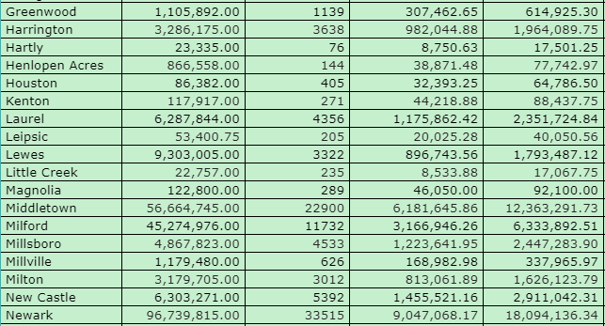
Appendix A-2 – By the Numbers, Delaware
https://treasurer.delaware.gov/arpadb/

Slide 24
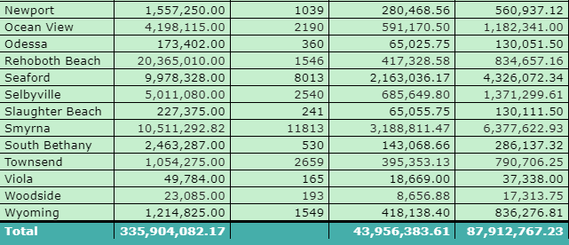
Appendix A-3 – By the Numbers, Delaware
https://treasurer.delaware.gov/arpadb/

